Slide 1
Summer 2012 Internship Symposium
Omid Sadeghpour
IT Manufacturing & Engineering Intern
August 20th, 2012

Slide 2
Agenda
Hello!
Intro – IT Manufacturing & Engineering
Software Life Cycle (SLC) Process
Project 1: Global Engineering Collaboration
Project 2: New Instrument & Modification Process
Project 3: Global Manufacturing Portal
Intro
SLC
Projects

Slide 3




Hello!
Why
My name is Omid – UC Berkeley Bioengineering
First employee at Biotech startup ($22.5 M Series B)
Joint Genome Institute Big-Data Software Dev.
MIT Sloan MBA ‘13
And I love drawing photorealistic birds
Intro
SLC
Projects

Slide 4



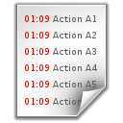


Manufacturing & Engineering
Why
Manufacturing
IT Manufacturing & Automation Eng.
Everything involved in making our products
Anything IT related that allows manufacturing to work as effectively as possible
Bioreactor
Management
Software Deployment (Windows 7, SharePoint)
Facilities & Construction
Data & Analysis (DeltaV, Pi, etc)
API Batches
New Application and Process Development
Intro
SLC
Projects
Notes:
As we all know, BIIB focuses on creating the API for products that require large biological molecules. The creation of such large biological APIs are our bread and butter. Consequently, the IT Manufacturing and Engineering group provides the information backbone that allows automation engineering and manufacturing to operate effectively.
Critical manufacturing and automation systems such as the real-time Delta-V bioreactor sensors, the Disoverant causation/correlation tool, the Pi data center – are manage by automation engineering and further bostered by the IT manufacturing group. Aside from real-time information IT Manufacturing also focuses on providing collaboration platforms that aim to engender a culture of teamwork between the engineering and manufacturing groups. These collaboration platforms are both for internal and external uses.
Given that IT Manufacturing focuses much of their effort in developing new collaboration portals and custom-made applications, allow me to briefly explain the Software Life Cycle (SLC) process.

Slide 5


Software Life Cycle (SLC)
Why
Business Challenge
Solution
10
Requirements gathering
Implementation
7
Deployed Solution
5
Process and UI design
Verification & Testing
3
4
Maintenance
Intro
SLC
Projects
30
Notes:
The incentive for the development of any piece of software is to fix the frowning face of a business unit. Once a business challenge is identified, IT Manufacturing is contacted and we begin by gathering the details of the current process, and later on, the solution the business envisions.
Requirements gathering is a bit complex since one has to be impartial to any particular solution until all the details have been discovered.
After the requirements gathering we re-design the business process and mockup the user interface of the best possible solution and anticipate how all the actors of the process will engage with the solution.
After everything has been figured out we attempt to get an implementation timeline from the software development group, and make sure the business has all their timeline expectations met.
Post implementation there is a whole lot of testing before the solution is deployed to production where the business unit is finally smiling.
Post solution delivery – IT Manufacturing also deals with support, continuous maintenance, training, etc.
Now, this looks very straight forward, but the challenge begins when you juggle 1-30 projects in each of these stages and attempt to synchronize timelines, resources and deliverables
To continue, I will present three of the many projects that I was partially involved with this summer, and elaborate on their impact and how these move us forward into the Next culture BIIB is moving toward

Slide 6
Project 1: Global Engineering Collab. Space
Why
Global Engineering works on projects between $500K and $20M
Require the collaboration of hundreds of employees and remote contractors
They needed a collaboration solution that could quickly create a collaboration “project space”
Intro
SLC
Projects
Need
Solution
Impact

Slide 7
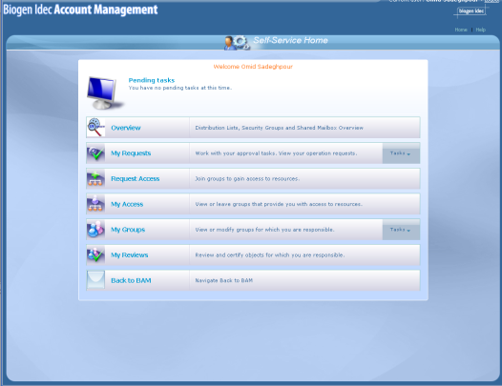
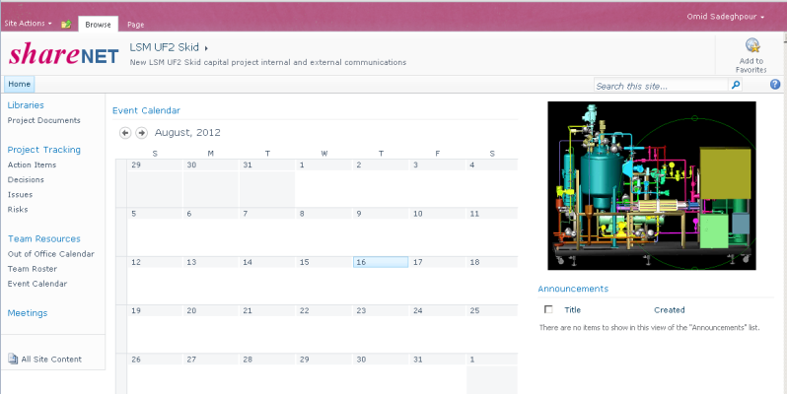
Project 1: Global Engineering Collab. Space
Why
A system that could generate a collaboration space with a directory structure of over 550+ folders, that is easily searchable, and manageable
One-click deployment via BAM
Intro
SLC
Projects
Need
Solution
Impact

Slide 8



Project 1: Global Engineering Collab. Space
Why
Doing something that used to take weeks reduced to a few minutes
Search functionality allows for quicker cross-checking and validation of designs decreasing errors
Export feature allows for end-of-life projects to easily be archived
Engineers can focus on engineering rather than IT
Better collaboration across BIIB and outside contractors; leading to quicker projects at lower cost
Intro
SLC
Projects
Need
Solution
Impact
Notes:
Time, lowering errors, end of life archiving for future reference, focus, collaboration

Slide 9
Project 2: New & Modify Instrument Process
Why
RTP Metrology group has two 6-step GMP processes that needed improvements: (1) new instrument introduction and (2) instrument calibration
Needed to move the logistics of the process from Lotus Notes to SharePoint
Wished to simplify their process to be more effective at managing these two processes
Intro
SLC
Projects
Need
Solution
Impact

Slide 10


Project 2: New & Modify Instrument Process
Why
A SharePoint workflow form that notifies responsible actors of a process
A process queue that is easily searchable and administered
System that tracks data history in order to meet GMP requirements
Intro
SLC
Projects
Need
Solution
Impact

Slide 11






Project 2: New & Modify Instrument Process
Why
Minimizes errors and lag time by enabling users to search and be notified more effectively
System keeps track of information history, making audits and historic data retrieval less time consuming
Notifications allows the process to manage itself to the point of completion, saving resources and minimizing costs
Intro
SLC
Projects
Need
Solution
Impact
Notes:
Time, lowering errors, end of life archiving for future reference, focus, collaboration

Slide 12
Project 3: Global Manufacturing Portal
Why
Global Manufacturing needs a way to communicate macro and micro level news, information, presentations, at a global level
Requires a communication platform to quickly share best practices, standards, and schedules to improve manufacturing techniques at all sites
Needs a video blog to share videos that aligns the culture of manufacturing with NEXT principles
Intro
SLC
Projects
Need
Solution
Impact

Slide 13


Project 3: Global Manufacturing Portal
Why
Continuation of a project started by Lira Mishra (IT Mnfg & Eng.)
A global manufacturing SharePoint site with area-specific sections
A one-stop-shop for manufacturing documents and best practices that connect Cambridge, RTP, Hillerød
A communication and deployment strategy to gain sponsorship at the different areas, starting with Cambridge
Intro
SLC
Projects
Need
Solution
Impact

Slide 14
Project 3: Global Manufacturing Portal
Why
Allows faster response time and news distribution for manufacturing at a global level
Provides a tool for higher level management to align manufacturing personnel with the NEXT culture
Connects all manufacturing resources (i.e: training, support, resources) to ensure best practices are used across BIIB
Intro
SLC
Projects
Need
Solution
Impact
Notes:
Time, lowering errors, end of life archiving for future reference, focus, collaboration

Slide 15
Conclusion & Questions
Why
Many of this summer’s project revolved around applying the NEXT culture into IT Manufacturing
Thank you for all the lessons learned and experience gained at BIIB
Mutual Respect, Trust, Honesty, Integrity & Ethics
Focus on Priorities/ Sense of Urgency
Innovation & Creativity
Crisp, High Quality Decision Making
Accountability
People Management
Collaboration/ Teamwork
Mutual Respect, Trust, Honesty, Integrity & Ethics
Focus on Priorities/ Sense of Urgency
Innovation & Creativity
Crisp, High Quality Decision Making
Accountability
People Management
Collaboration/ Teamwork
By creating better ways to collaborate, focus, innovate, and make better decisions
Questions?

